Slide 1
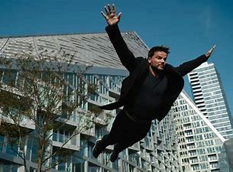
Abstract of Bjarke Ingels
Ethan Gray, John Leahy, Aidan Ritter, Aidan Sharpe

Slide 2
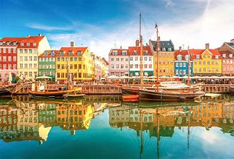

Background and Personal Life
Denmark native (Copenhagen)
Originally planned on military
Strived to become a cartoonist
Studied architecture in Barcelona
Notes:
Bjarke Ingels was born in Copenhagen, Denmark and grew up with his mom, Elizabet, and his dad, Knud, as well as his dog Fidel. Elizabet was a dentist and Knud was an engineer. Bjarke grew up loving creativity, and wanted to be a cartoonist, although he thought that realistically he would end up in the military. Eventually Knud realized Bjarke’s creative potential and got him into architecture, which was when he began to study in Barcelona.

Slide 3
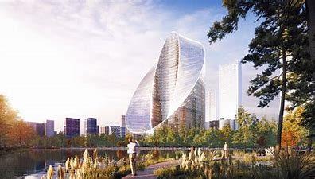

Occupation
Major architect
Bjarke Ingels’ Group (aka BIG)
Notes:
Bjarke Ingels began his studies of architecture in Barcelona where he started a small firm with his friends. This firm after a few years grew into a huge corporation, Bjarke Ingels Group (aka BIG). They originally did most of their work in Bjarke’s hometown of Copenhagen, but eventually expanded internationally. This company grew so big that at one point in 2019 (When the netflix documentary episode released) the company had 17 construction sites at once.

Slide 4




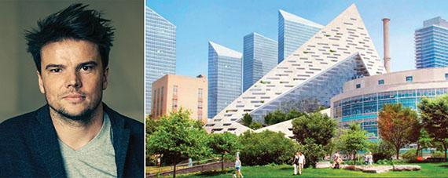

Contributions to Society
Founder and Creative Partner of the Bjarke Ingels Group (BIG)
Multiple projects around the world
Influenced the innovation of modern architecture
Environmentally friendly designs
Notes:
Bjarke Ingels’ most notable contributions to society includes his involvement in the creation of his company BIG, based in Copenhagen and New York. His involvement in architecture has led to numerous innovative, environmentally friendly projects around the world, in countries such as Japan, Denmark, France, Norway, United States and more.

Slide 5
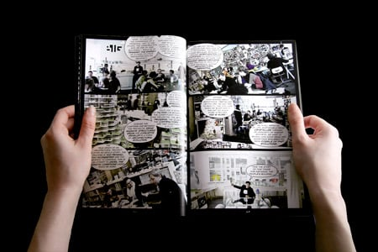
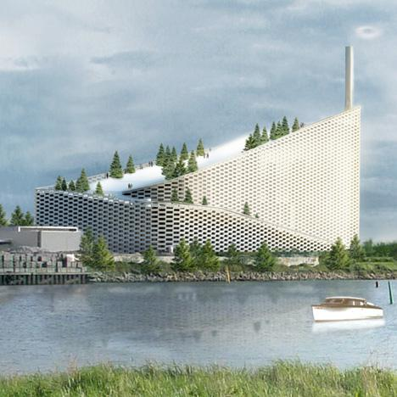
Mindset
Turning fiction into reality
Hedonistic Sustainability
Archicomic
Notes:
Bjarke Ingels’ mindset is arguably the biggest reason for his success and his impact on architecture. He is not afraid to break the rules in his work, and anything that other architects feel is fiction he turns into a reality, as shown by some of his divergent designs (in comparison to the average architecture). Hedonistic Sustainability is a term coined by Bjarke, which means that sustainability can and should be pleasurable, and this gives him his edge over the rest. Not only is his creativity changing the architectural world, but also changing the way to get his work out to the world… in comic form. The Archicomic is a manifesto about the growth and improvement of the architecture in Copenhagen written by BIG, and can be seen in the image on the right. Bjarke also is a big fan of environmentally friendly work, such as the smoke stack and the mountain. What makes these two environmentally friendly is that the smoke stack is designed to blow the rings up to a certain height to where they won’t dissipate at a harmful level, and the mountain incorporates green roofs onto every apartment which can reduce the temperature of the building by not taking in so much sunlight.

Slide 6
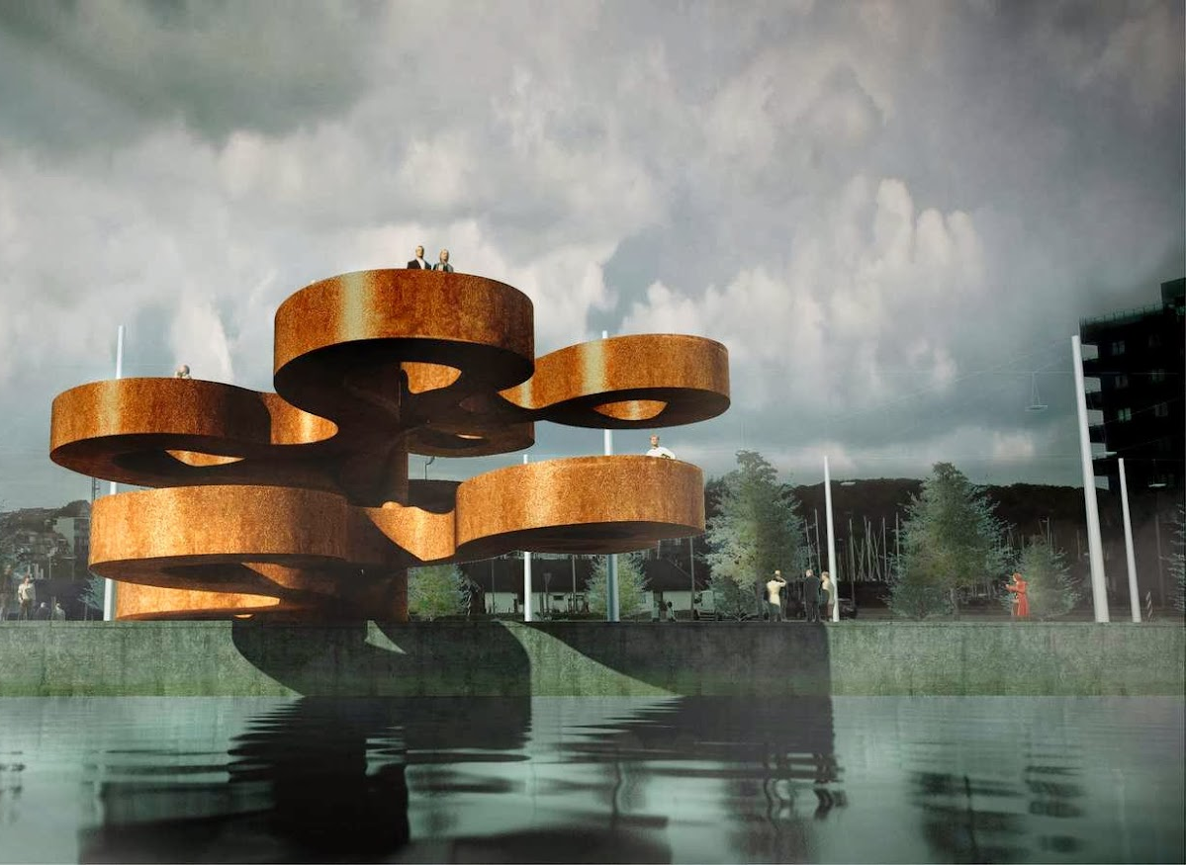

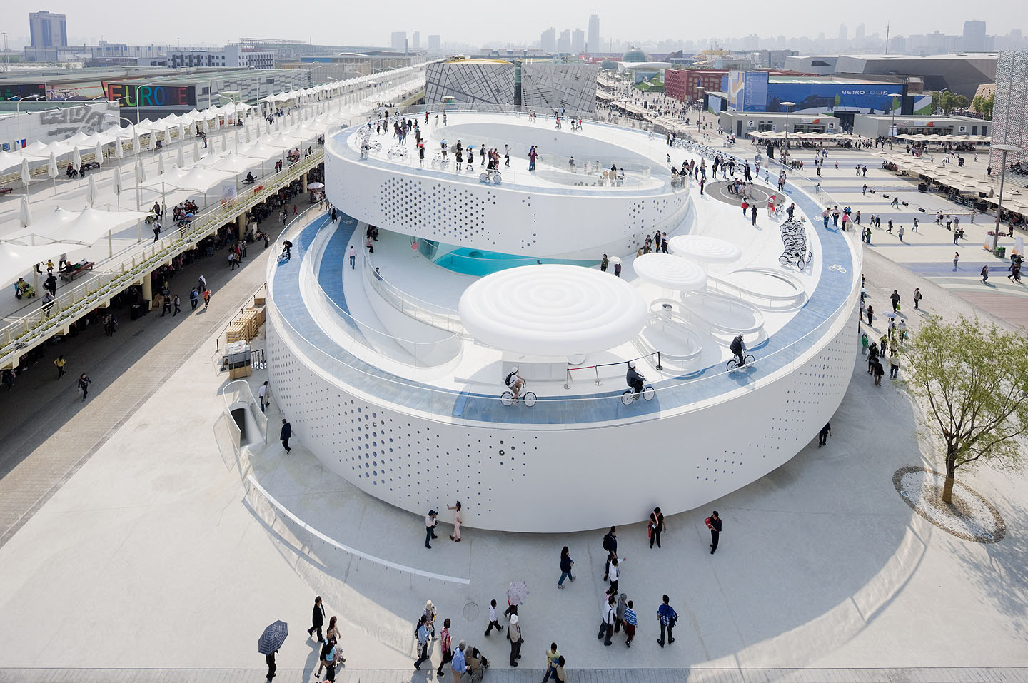
What makes his architecture unique?
Notes:
There is a uniqueness to the field of architecture, and this uniqueness is the creativity involved. Creativity is ultimately what makes the architect stand out, and Bjarke is no exception. His combination of function and beauty yields such an interesting design, and this all stems from his never-faltering ambition from the start of the project.

Slide 7
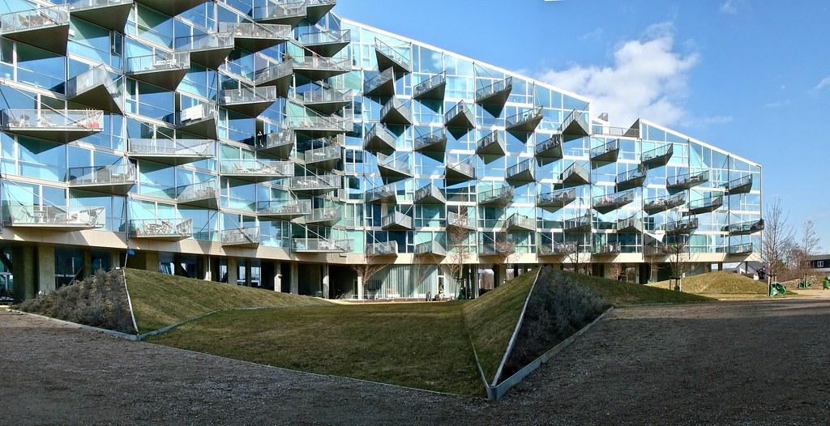
Famous works (VM house)
Notes:
The VM house in Copenhagen was a breakthrough in architecture due to its innovative layout that allowed for as many rooms to fit inside as possible while still giving everyone their own space.

Slide 8
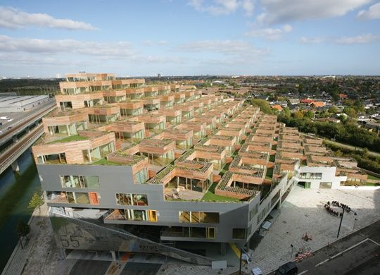
Famous Works (The Mountain)
Notes:
The Mountain in Copenhagen was essentially a staircase of homes, another design that fit as many rooms as possible while still spreading everyone out. Each individual even got their own secluded garden.

Slide 9
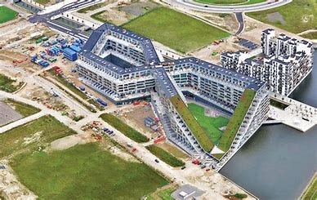
Famous Works (8 house)
Notes:
The 8 house in Copenhagen was designed with the thought of optimizing space and aesthetic at the same time, while making the shape of an 8 (Thus the name)

Slide 10
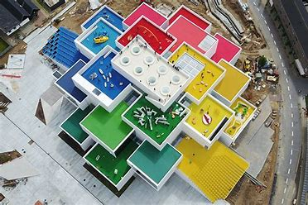
Famous Works (Lego house)
Notes:
The LEGO house, obviously inspired by legos, is a structure designed as an exhibit in Billund, Denmark that brings fun lego builds into a life-sized scale.

Slide 11
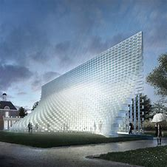
Famous Works (Serpentine Gallery Pavilion)
Notes:
Finally, the Serpentine Gallery Pavilion of 2016 in England is the design that Bjarke worked on with his team throughout the documentary. This beautiful work of architecture is simply a standard wall, however the building blocks are distorted in a way that creates a shape so that it gives the illusion of “unzipping”.

Slide 12
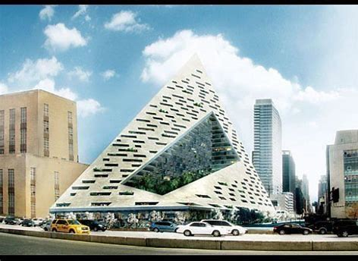
How does it relate to engineering?
Keeping functionality in mind at all times
Open to creativity and new ideas for the betterment of the project
Architecture requires deep understanding of math and science
Notes:
Keeping functionality in mind at all times
Open to creativity and new ideas for the betterment of the project, example being incorporating the Green Areas in designs
Architecture requires deep understanding of math and science (Ex. Physics for weight science and materials science for strength vs. cost of building
New Ideas like the picture.
West 57th NYC Residential Building concept design
Pyramid is a brand new idea from BIG, which incorporates green areas in the cutout portion of the pyramid and living space.
This also fits the NYC skyline very nicely according to Bjarke.

Slide 13
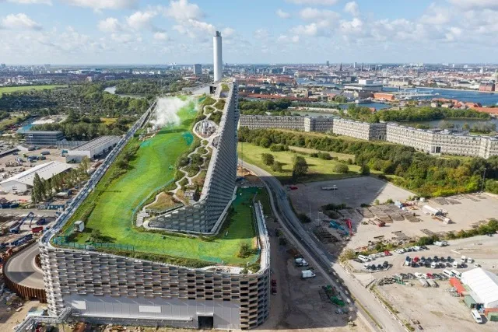
Copenhill
Notes:
Epicenter for urban mountain spots
Offers outdoor activities for the city of Copenhagen
Hiking, Skiing, Rock Climbing, Running
Gives the people of Copenhagen opportunities to develop new hobbies and ambition that can better themselves physically and mentally.

Slide 14
References
Abstract: The art of design | Bjarke Ingels ... - youtube. (n.d.). Retrieved March 9, 2022, from https://www.youtube.com/watch?v=rKeFCd1j5BE
VM House
NYC Residential Pyramid
News. BIG. (n.d.). Retrieved March 9, 2022, from https://big.dk/#projects
Møller, A. (2013, May 6). Yes is more: The big philosophy. ArchDaily. Retrieved March 9, 2022, from https://www.archdaily.com/366660/yes-is-more-the-big-philosophy
Designing a hedonistic and sustainable future. Big Think. (2021, September 30). Retrieved March 9, 2022, from https://bigthink.com/guest-thinkers/designing-a-hedonistic-and-sustainable-future/#:~:text=Taking%20a%20big%20picture%20view,thinking%20about%20them%20as%20ecosystems.
Lego House
8 House Website and Picture
The Mountain Picture and Info
Copenhill Info and Picture

